Slide 2

Machine Learning Fundamentals with Python
John Sukup - Instructor

Slide 3

Instructor Introduction
12 Years in research and data analytics with The Nielsen Company, BlueCross BlueShield, and others
Model development for Department of Energy’s SPR and Telemedicine Impact Score projects
Business experience across several industries including healthcare, CPG, energy, financial services, insurance, consumer tech, and manufacturing
Expertise in data modeling, Big Data solutions consulting, Python, R, Microsoft Cognitive Services, etc.
MS/BS Purdue University and several professional certifications

Slide 4
Course Setup

Slide 5
Prerequisites…
This course assumes no knowledge of Machine Learning (ML)
You will use production-ready Python frameworks and packages, mainly Scikit-Learn
Some familiarity with college-level math, Python programming and scientific libraries
Pandas
NumPy
Matplotlib

Slide 6
Classroom Setup

Slide 7
Before you get started…
Course is delivered via BigBlueButton, a web conferencing tool for online educational
You should have already reviewed the tutorial provided via a link in your email
Labs administered in Jupyter Notebooks via Google Colaboratory
You will need a Google account and Chrome to run labs
Please keep yourself muted and phones on silent/vibrate during class

Slide 8
Do you meet the prerequisites, and have you watched the BBB intro video?
(Yes/No)

Slide 9
The Machine Learning Landscape

Slide 10

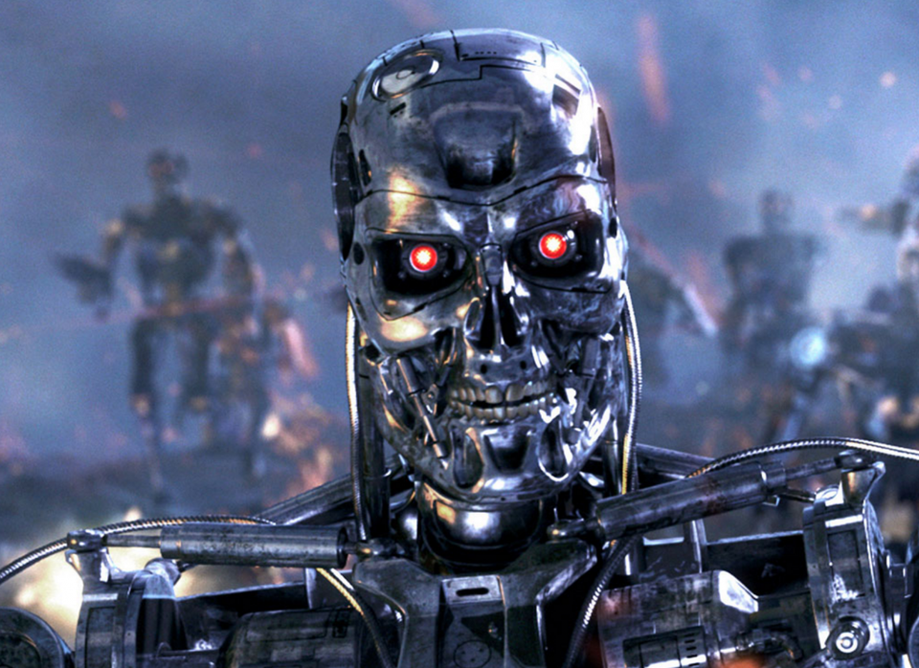

Slide 11
“[Machine Learning is the] field of study that gives computers the ability to learn without being explicitly programmed.”
—Arthur Samuel, 1959
“A computer program is said to learn from experience E with respect to some task T and some performance measure P, if its performance on T, as measured by P, improves
with experience E.”
—Tom Mitchell, 1997

Slide 12
Spam Detection: What is ML?
Examples of Spam email flagged by users
These examples are called Training Data
Task T: Flag new Spam emails
Experience E: Flagged training data
Performance P: Measure of how well our model works
Ratio of correct predictions to all emails seen (called Accuracy)

Slide 13
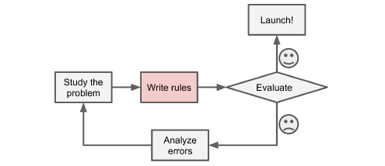
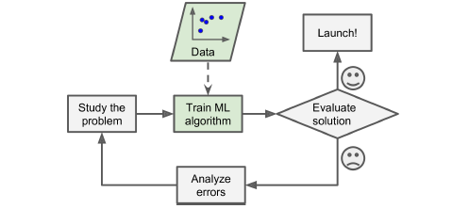
Spam Detection: Why Use ML?
Traditional Programming
Observe commonly occurring words and phrases
Write program – long list of complex rules
Machine Learning
Automatically learns commonly occurring words and phrases
Automatically adapting to change

Slide 14
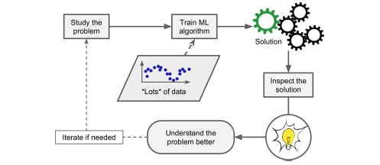
More ML Use Benefits…
ML can aid humans, themselves, in learning
Looking “under-the-hood” of an ML Spam detection algorithm to see what words/phrases it finds most important in detection
Data Mining: Applying ML to large amounts of data to discover hidden patterns

Slide 15
Types of ML Systems
ML systems can be broadly categorized based on three aspects of how they learn
Can they be trained with or without human supervision?
Supervised
Unsupervised
Semi-supervised
Reinforcement
Can they learn incrementally in real-time?
Online
Batch
Do they learn by comparing new data observations to old ones or do they build predictive models?
Instance-based
Model-based

Slide 16
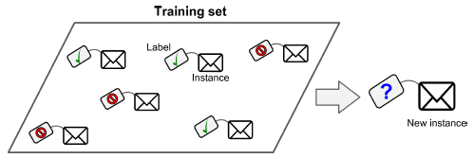
Supervised Learning
ML algorithm is trained with data including the desired solution, or label
Example: Predicting the class of an email as Spam/Ham (Classification)
Example: Predict the price of a car based on mileage, brand, etc. (Regression)
Predicting labels given Features or Predictors

Slide 17
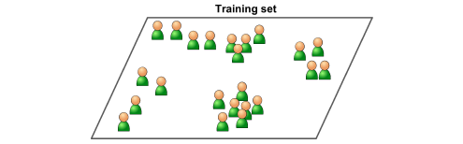
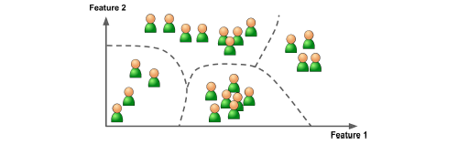
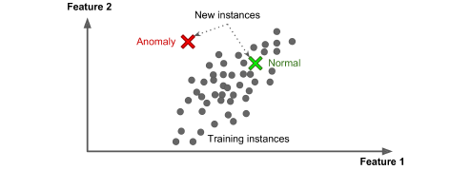
Unsupervised Learning
ML algorithm is trained with unlabeled data to find patterns between observations
Example: Market segmentation via Clustering
Example: Feature extraction via Dimensionality Reduction
Example: Fraud detection via Anomaly Detection

Slide 18
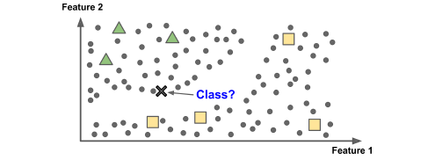
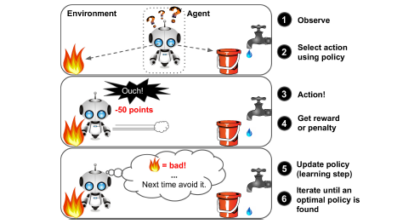
Semi-supervised and Reinforcement Learning
Semi-supervised
Deal with partially labeled data
Example: Google or Facebook photos recognize faces across pictures – need human-supplied labels (i.e. people’s names)
Reinforcement
An agent observes an environment, selects/performs actions, and receives rewards/penalties based on action result
Example: AlphaGo trained to learn game of Go – defeats world champ Ke Jie in 2017

Slide 19
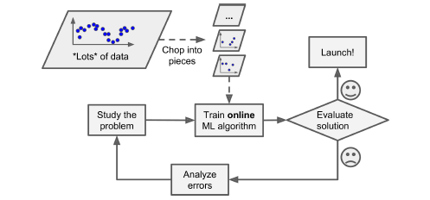
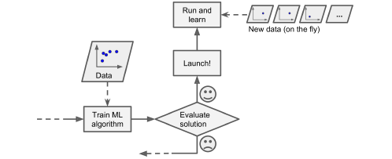
Online and Batch Learning
Batch
ML system trained and productionized without additional learning
Needs to be retrained from scratch each as needed
Online
ML system trained incrementally by providing new data sequentially
Useful for systems with continuous flow of data and/or limited storage
Requires performance monitoring

Slide 20
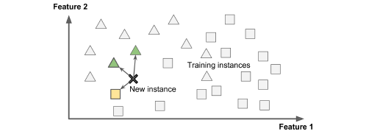
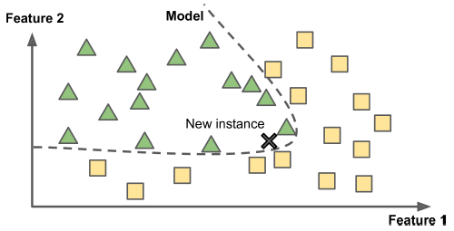
Instance-based and Model-based Learning
Instance-based
Learning by memorization
Measuring similarity between training data and new examples
Performs poorly as data evolves
Model-based
Learning by fitting a mathematical model
Models contain parameters, θ, that are learned during training

Slide 21
Model-based Learning
Jump to Colaboratory!

Slide 22
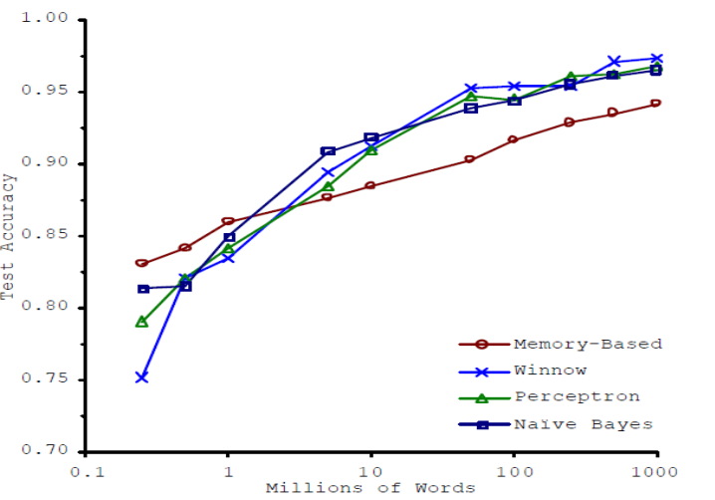
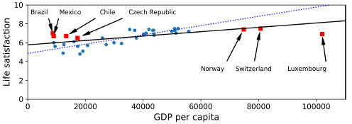
Machine Learning Challenges
Not enough training data
Complexity of problem often dictates amount of data needed
Quality and quantity of data potentially more important than algorithm choice
Non-representative training data
ML models will fail if training data are dissimilar to new data
“Small data” – Sampling Noise
“Large data” – (Potential) Sampling Bias

Slide 23
Machine Learning Challenges
Poor data quality
Data is often messy and needs to be tidy for ML algorithms to work correctly
Measurement error
Outliers
Missing values
On average, Data Scientists spend ~80% of their time fixing data quality issues
Feature irrelevance
ML algorithms will work on any kind of data they’re given – “garbage in, garbage out”
Critical to ML success: Feature Engineering
Feature selection: Selecting most important features to train on
Feature extraction: Combining feature to create more useful ones

Slide 24


Slide 25
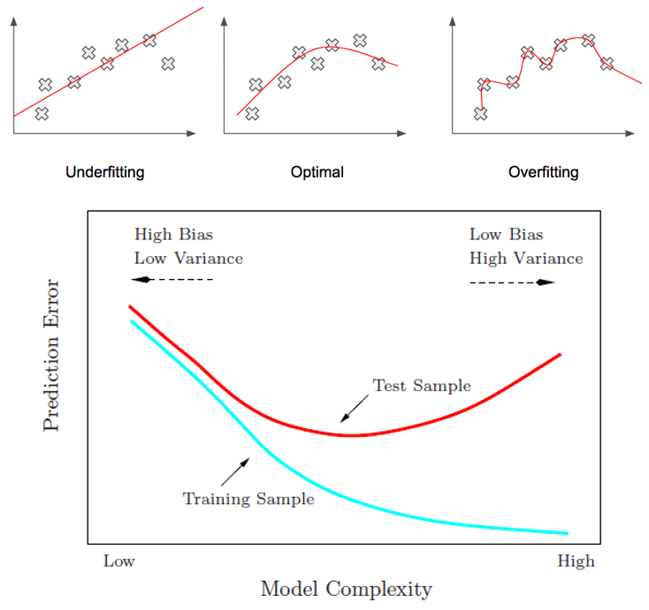
Machine Learning Challenges
Overfitting
Training a model too complex relative to sample noise
Resulting model does not generalize well to new data
Possible solutions:
Constraining model complexity (Regularization)
Obtain more training data
Reduce sample noise with better measurements
Models can also be Underfit if not complex enough
Bias/Variance Tradeoff
Precision/Recall Tradeoff

Slide 26
Machine Learning involves explicitly programming sets of rules for making predictions about future data.
(True/False)

Slide 27
You observe that the price of a home seems to increase linearly with the number of rooms and square footage. You want to use linear regression to try and predict home price using these two features. This is and example of…
Instance-based learning
Unsupervised learning
Model-based learning
Batch learning

Slide 28
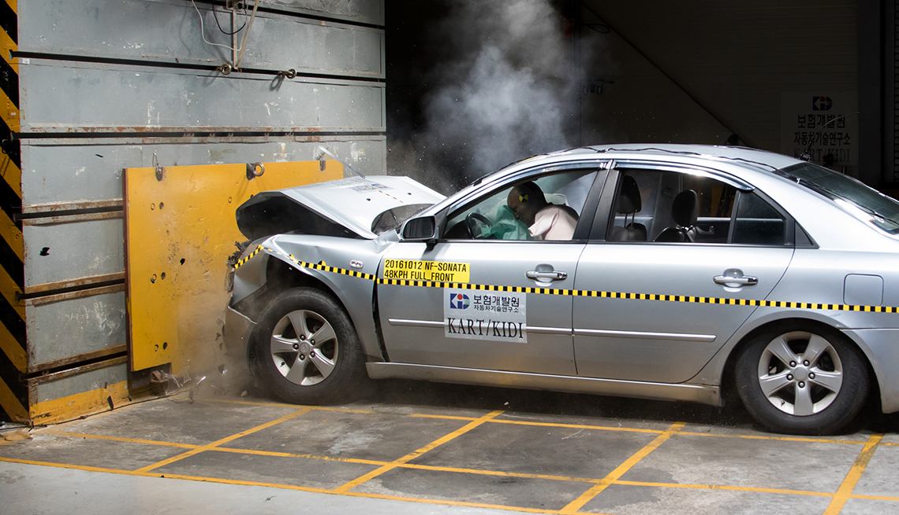

Slide 29
Model Testing and Validation
How can you tell if our trained ML model will work well on new data?
By splitting data into Training data and Testing data we can simulate model performance on new, unseen data
This allows us to estimate Generalization error by comparing a model’s predictions to the actual label of observations in the testing data
Sometimes called Holdout Testing
Models with low error on training data but high on testing data = overfitting

Slide 30
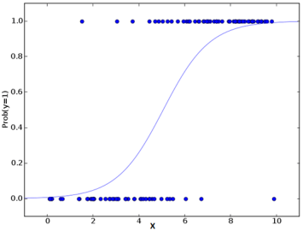
Holdout
TRAINING
TESTING

Slide 31
Holdout with Validation
TRAINING
TESTING
VALIDATION

Slide 32



# of Coffee Cups Drank
# of Resources Studied
# of Practice Tests Taken

Slide 33
Hyperparameter Optimization
ML using model-based learning trains models to learn the parameters, θ, of our mathematical formalization between features and labels
Slope and y-intercept are examples of parameters in linear regression
Learned from training data
Hyperparameters or tuning parameters tell the model how to train
Provides constraints or weights on how the parameter learning process should proceed
Grid Search and Random Search are popular approaches for finding the best hyperparameters
Holdout with Validation or Cross-validation can be used to “tune” parameters without exposing model to testing data

Slide 34
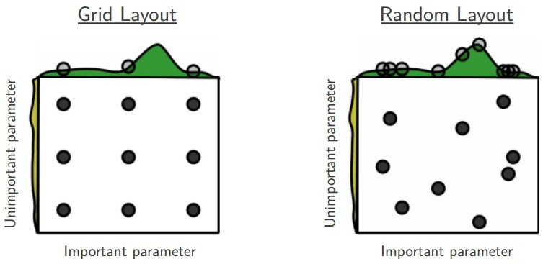
Hyperparameter Optimization

Slide 35
You are training an autonomous vehicle how to navigate through unknown terrains. What type of ML learning will you implement?
Supervised learning
Unsupervised learning
Semi-supervised learning
Reinforcement learning

Slide 36
Your ML model performs well on the training data but poorly on the testing data. What has potentially occurred?
Supervised learning
Model-based learning
Underfitting
Overfitting

Slide 37
End-to-end Machine Learning Projects

Slide 38

The ML Real Estate Company

Slide 39


Slide 40
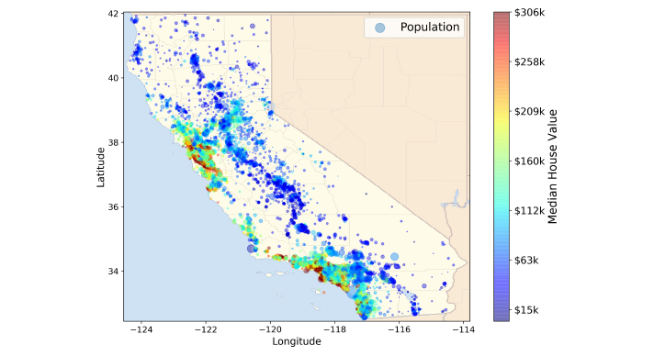
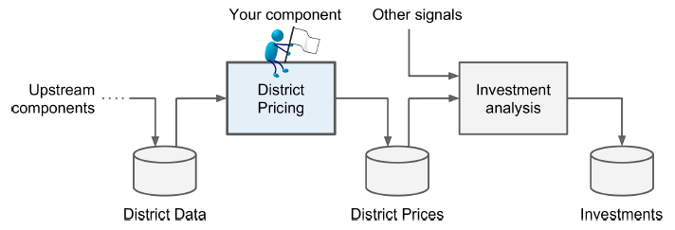
Business Understanding
What is the expected use and benefit of the model?
Determines problem framing, algorithm selection, Performance Metrics, and tuning
What is the current approach?
Determines baseline to measure success
Who is the Subject-matter Expert (SME) assigned to the project?

Slide 41
You’re tasked with building an ML model to predict the median price of home values within CA districts. You are given historic price data including median income, population, demographics, etc. by district. This is an example of a classification problem.
(True/False)

Slide 42
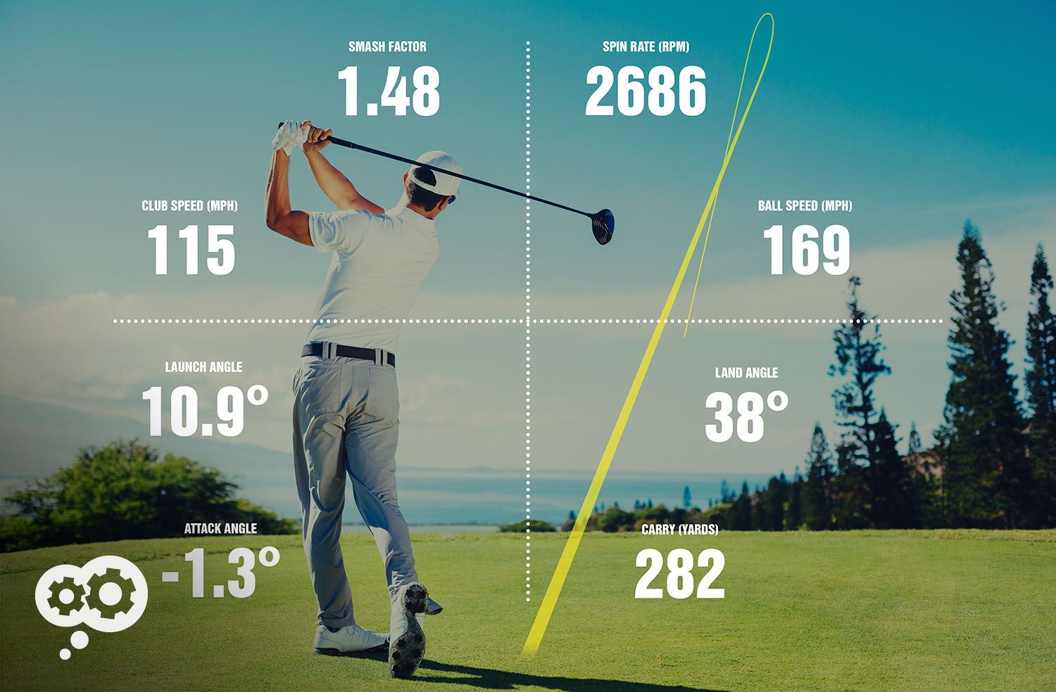

Slide 43
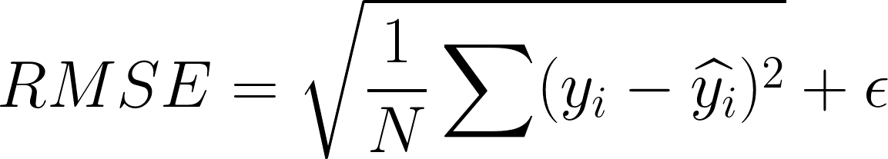
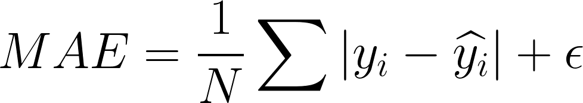
Business Understanding
Model success determined by performance metrics
Root Mean Squared Error (RMSE) measures difference between actual and model-predicted values, penalizing bigger errors
Mean Absolute Error (MAE) measures difference between actual and model-predicted values, allowing for outliers
Both measure Distance between vectors

Slide 44
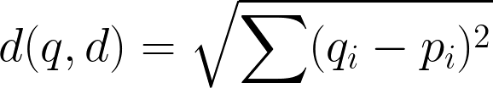
Obs. | X1 | X2 | X3
1 | 18 | 20 | 14
2 | 15 | 13 | 19
3 | 23 | 19 | 10
4 | 24 | 12 | 15
5 | 11 | 12 | 13
Obs. | X1 | X2 | X3
D1 | (18-11)² = 49 | 64 | 1
D2 | (15-11)² = 16 | 1 | 36
D3 | 144 | 49 | 9
D4 | 169 | 0 | 4
Sum
= 114
= 53
= 202
= 173
Sqrt
= 10.7
= 7.3
= 14.2
= 13.2

Slide 45
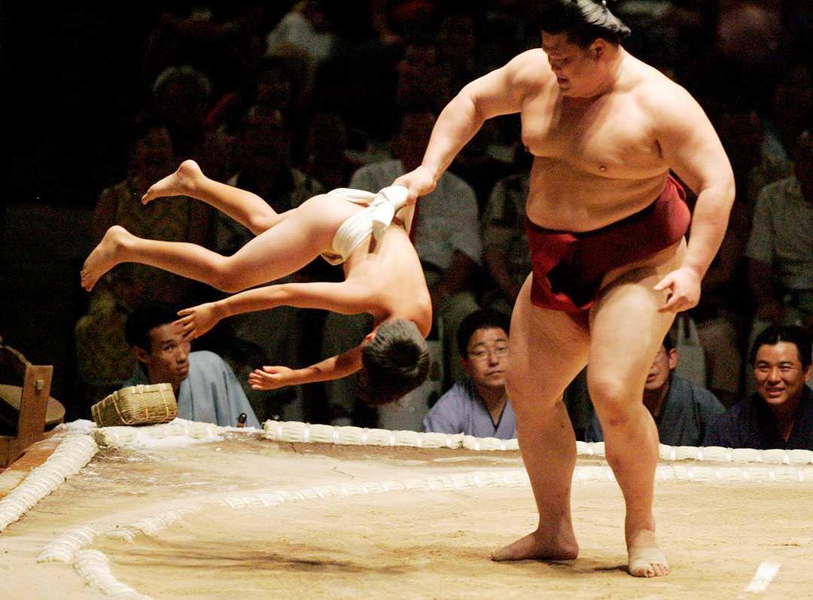

Slide 46
Quick Aside: Feature Scaling

Slide 47
Data Understanding and Data Preparation
Data Understanding
Collect initial data
ETL preparation
Data governance report
Describe data
Format, quantity, metadata
Data description report
Verify data quality
Identify errors
Data quality report
Data Preparation
Create training/testing sets
Explore and visualize data
Simple statistical analyses
Gain insights to exploit
Feature correlations/relationships
Feature engineering
Data cleaning
Missing values, errors, and how to address
Handling categorical features
Feature Scaling

Slide 48
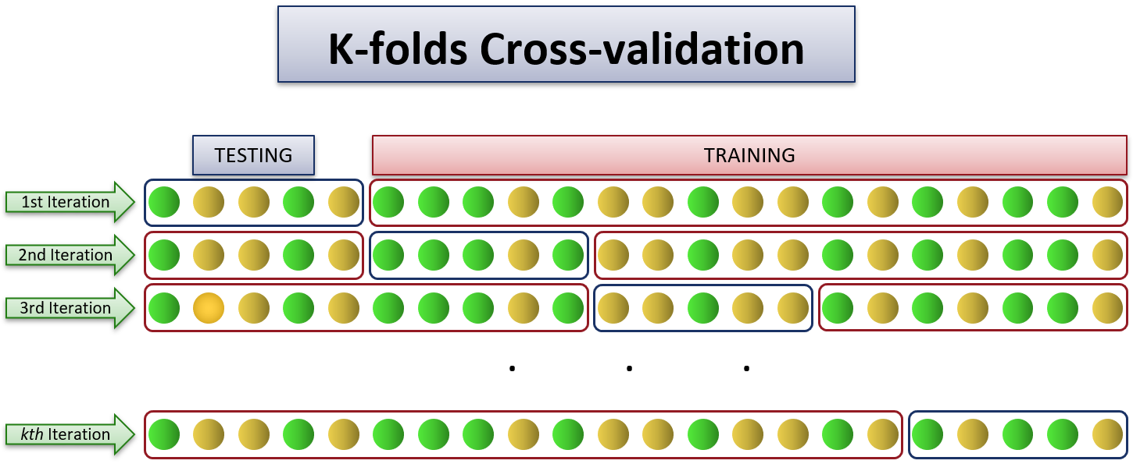
Modeling
Train model on training data
Training multiple models (No Free Lunch!) with performance metric comparisons
Evaluation using cross-validation
Provides estimation of performance and how precise the estimation is
Create shortlist of candidate models for further tuning and evaluation

Slide 49
Evaluation and Deployment
Evaluation
Hyperparameter optimization
Grid search tries exhaustive combinations of hyperparameters provided by data scientist
Random search tries random combinations of hyperparameters provided by data scientist
Ensemble Methods combine predictions from several slightly different models
Evaluate best performing model on test set
Deployment
Data scientist passes project off to Machine Learning Engineer
Pre-deployment considerations
Preparing models for a production environment
Cloud or on-prem deployment?
Resource cost estimation
Maintenance automation
Data quality monitoring
Model performance monitoring

Slide 50
While working with your data, you discover some districts either did not collect or did not include the ethnicity distributions. What stage of CRISP-DM would you address this?
Deployment
Evaluation
Data Preparation
Feature Engineering

Slide 51
You are tasked with estimating the cost of compute resources used by your ML solution annually and whether to deploy in using on-site or Amazon Web Services (AWS). You are most likely a…
Data scientist
Machine learning engineer
Subject-matter expert (SME)

Slide 52
The Machine Learning Pipeline
Jump to Colaboratory!

Slide 53
Classification

Slide 54
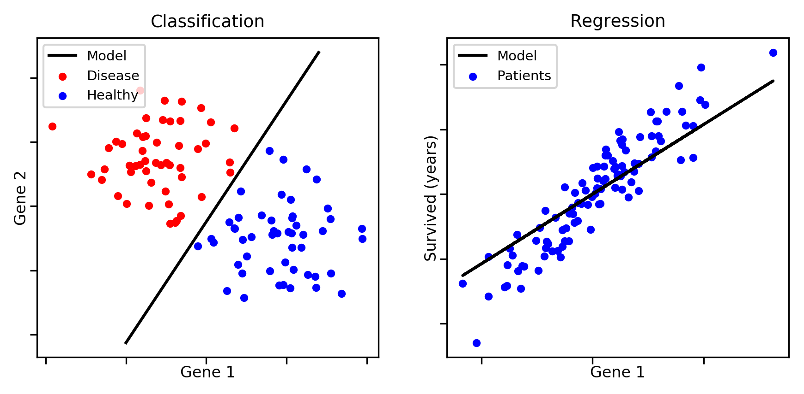
Qualitative Predictions
Quantitative Predictions

Slide 55
Classification Performance Metrics
Measuring prediction error with qualitative outcomes requires different performance metrics than regression
For binary (two class) classification, four possible outcomes when comparing model predictions to actual labels
True Positive (TP) – Model correctly predicts “positive” class
False Positive (FP) – Model incorrectly predicts “positive” class (Type I Error)
True Negative (TN) – Model correctly predicts “negative” class
False Negative (FN) – Model incorrectly predicts “negative” class (Type II Error)
Outcomes typically visualized in a 2x2 Confusion Matrix
Accuracy, Precision, Recall, and F1 Score summarize metrics

Slide 56
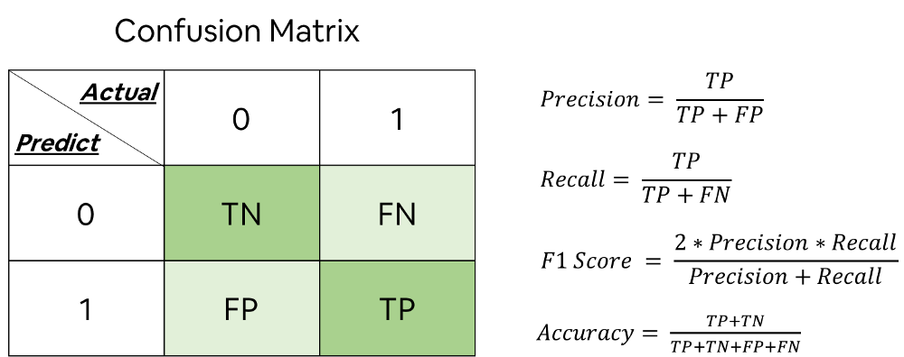
Confusion Matrix

Slide 57


Slide 58


Slide 59
Precision/Recall Tradeoff
In some contexts, high precision is preferred while in others, recall
Detecting videos safe for children – prefer high Precision
Detecting shoplifters in surveillance images – prefer high Recall
Increasing predictive Precision reduces Recall and vice versa
Binary prediction decisions score based on Decision Threshold
Most classification models predict positive class using probability
Naïve threshold default: p>.5 = positive class; p≤.5 = negative class
Raise threshold = Increase Precision/decrease Recall
Lower threshold = Decrease Precision/increase Recall
Selecting correct threshold typically done via visualizations

Slide 60
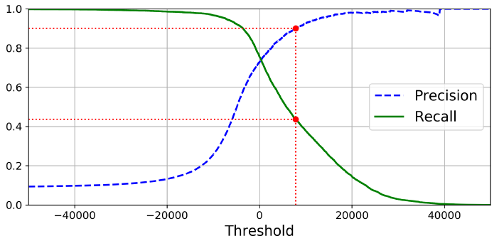
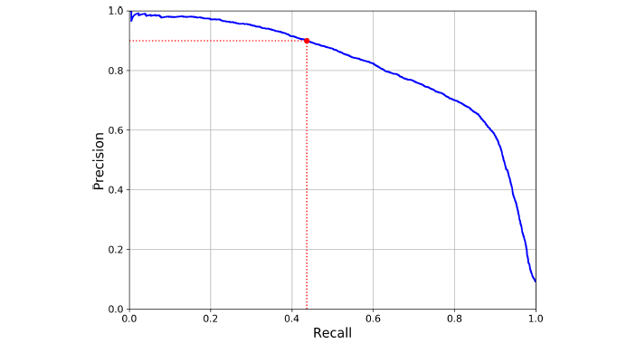
Precision/Recall vs. Threshold
Precision vs. Recall

Slide 61
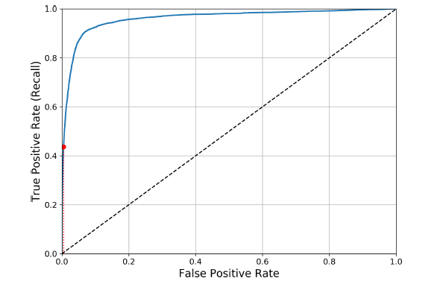
The ROC Curve
Receiver Operating Characteristic (ROC) plots Recall (or, True Positive Rate - TPR) against its opposite – the False Positive Rate (FPR)
Higher Recall, higher FPR
Good classifier’s line tends towards upper left
Dotted line indicates purely random classifier
Area Under the Curve (AUC) used for comparing classifiers
Perfect classifier will have AUC=1
Purely random classifier will have AUC=0.5

Slide 62
Multiclass Classification
When more than two classes exist, Multiclass Classification algorithms are appropriate
Some algorithms are purely binary classifiers but can be retooled for multiclass models
One-versus-All (OvA) creates binary classifier for each potential class and selects class with highest decision score (i.e. probability)
One-versus-One (OvO) creates binary classifier for each pair of classes and selects class with most “wins” between classifiers
Selection between OvA/OvO strategy typically based on size of training data

Slide 63
Multilabel and Multioutput Classification
Multilabel Classification utilized when an observation can assume more than a single, binary class
Ex: face recognition classifier of an image uploaded to Facebook
Ex: classify digits as being “>100” and “even/odd”
Multioutput Classification utilized when an observation can assume more than a single, multiclass
Can also mix with regression predictions
Ex: predict person’s hair color and eye color (classification only)
Ex: predict which baseball team will win and final combined score (classification and regression)

Slide 64
Raising the decision threshold of a binary classifier will do what to Precision and Recall?
Increase Precision/decrease Recall
Increase Precision/increase Recall
Increase Recall/decrease Precision
Decrease Recall/decrease Precision

Slide 65
When building a classification model to predict the presence of a chronic disease with low prevalence (i.e. rarely-occurring), what metric would be best to maximize?
Recall
Precision
Accuracy
F1 Score

Slide 66
Classification Models

Slide 67
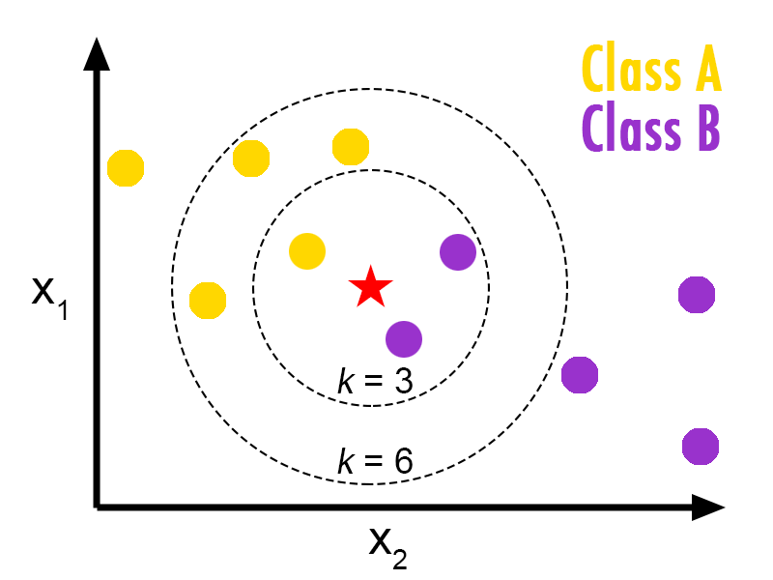
K-Nearest Neighbors
Instance-based learning
A priori – choose a numeric value for “K” (a hyperparameter)
How many “nearest” observations to look at to predict new observation’s class
Uses a “majority vote”
“K” value selected iteratively
Larger “K” reduces influence of noise
Severely impacted by irrelevant features or very noisy data

Slide 68

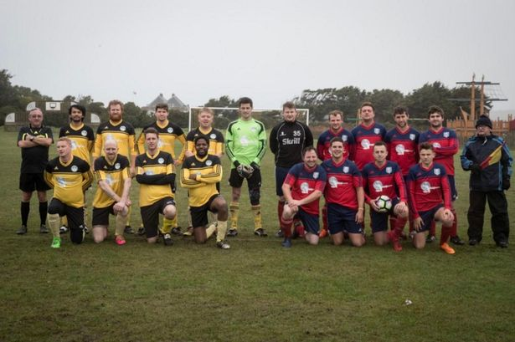
?
?
?

Slide 69
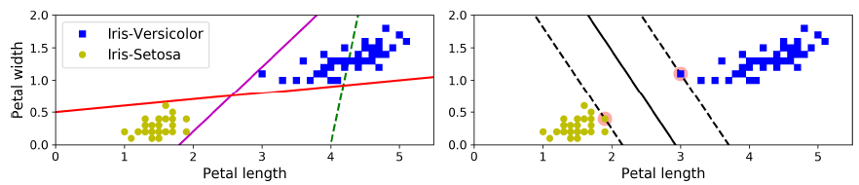
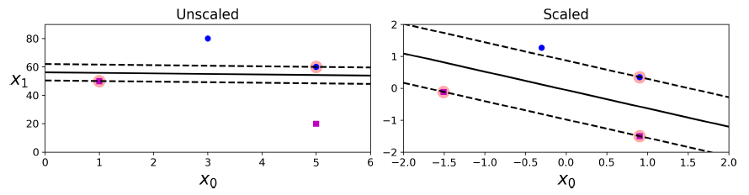
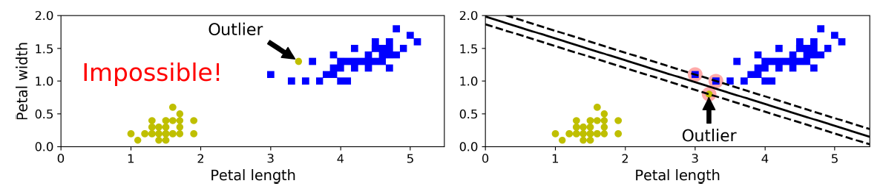
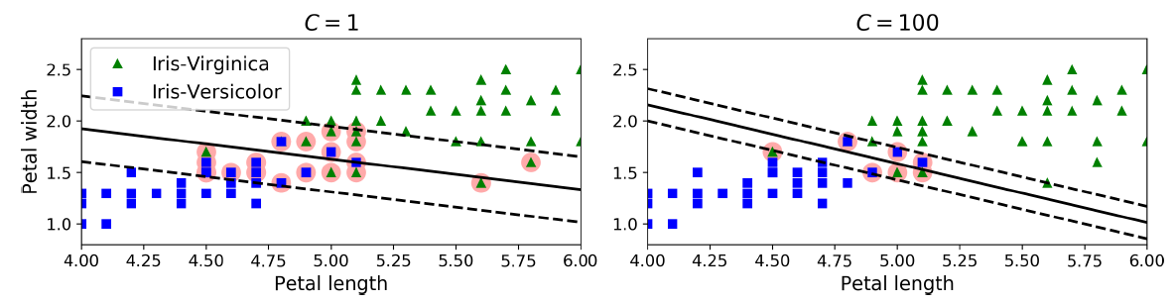
Support Vector Machines
Model-based learning
Many possible decision boundaries, which creates widest margin of separation?
Sensitive to feature scaling
Sensitive to outliers
Attempt to balance greatest boundary margin with misclassifications (hyperparameter “C”)
Small “C” = favor wider margin
Large “C” = favor thinner margin

Slide 70
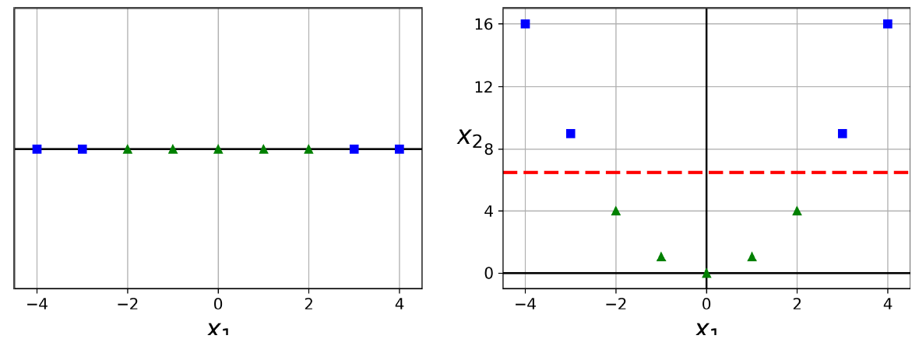
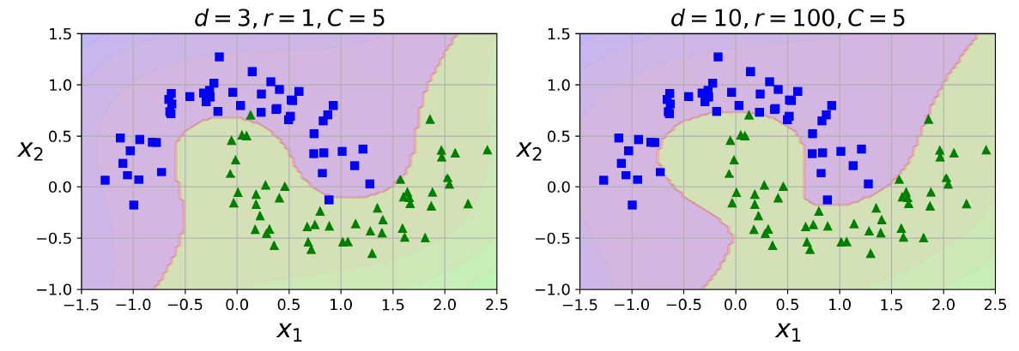
Support Vector Machines
SVMs excel on data not linearly separable
Uses the Kernel Trick to simulate adding features to aid in separability
SVMs also capable of handling regression problems
Opposite objective of classification – fit as many observations within the SVM margin

Slide 71
Decision Trees
Model-based learning
Algorithm searches through features to find feature/threshold combo that makes “purest” split
Susceptible to overfitting
Decision tree hyperparameters control “growth”
Stopping or Pruning Criteria
Gini Impurity/Entropy attempts to minimize misclassification at nodes
Capable of regression problems too

Slide 72
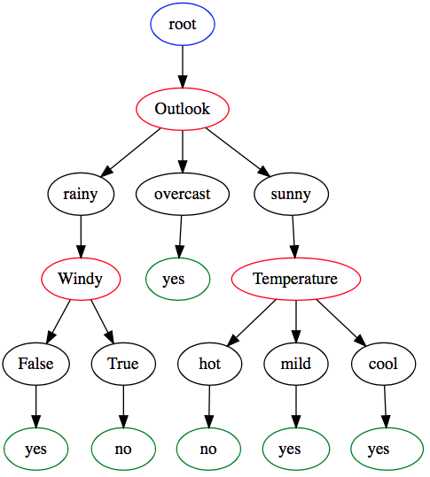
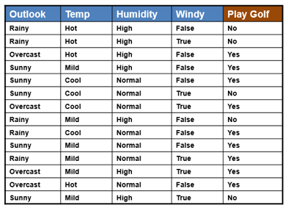
Decision Trees

Slide 73
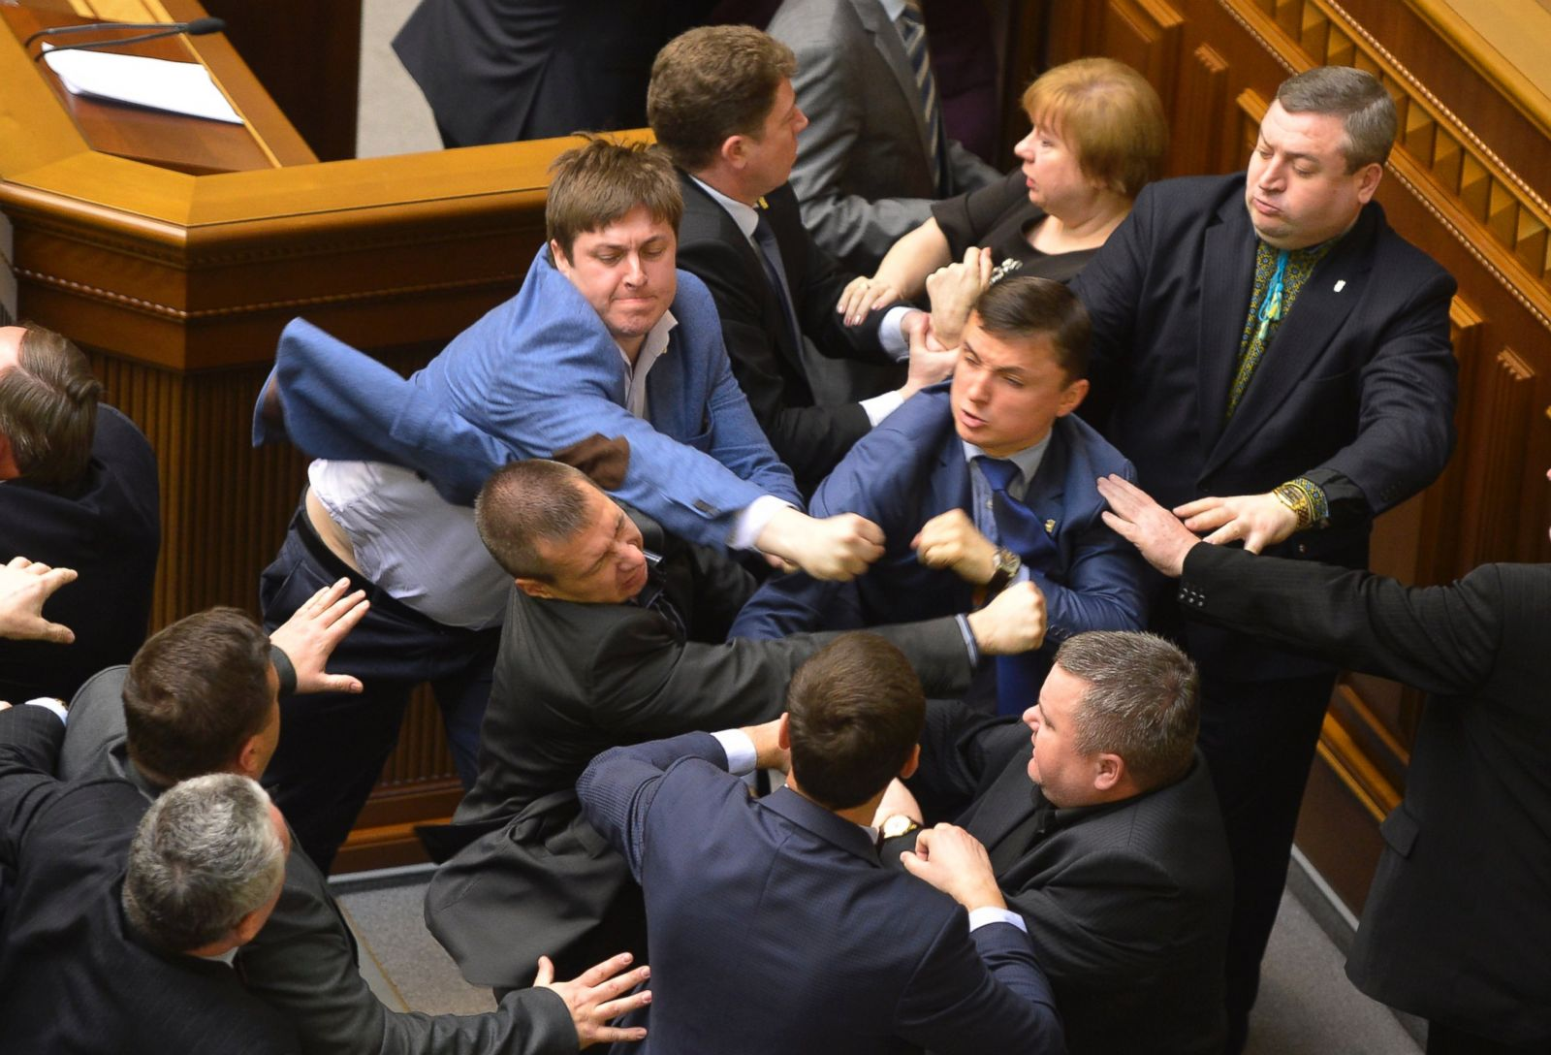

Slide 74
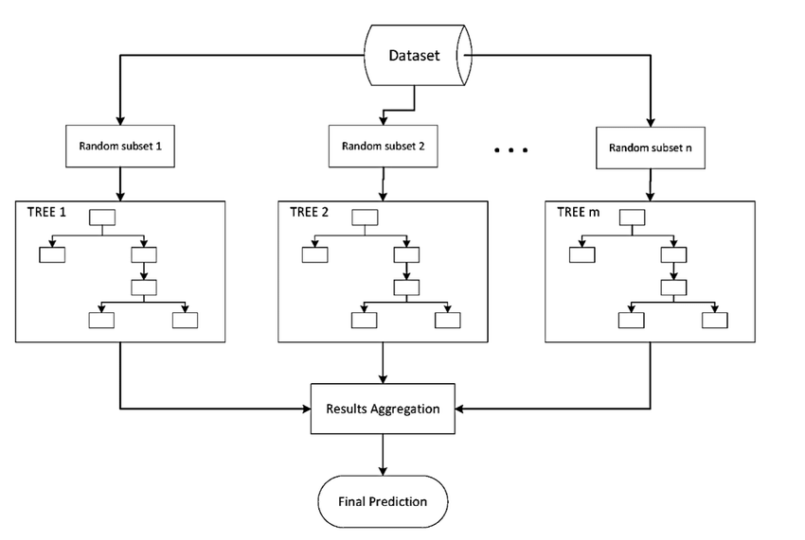
Ensemble Methods

Slide 75
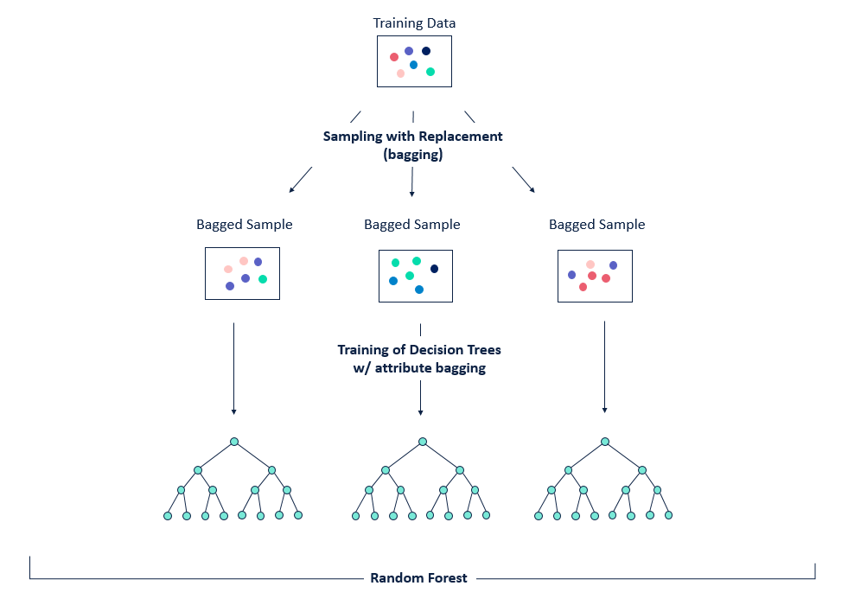
Random Forest
Ensemble Method
Builds multiple decision trees and uses a “majority vote”
Simulated data sets using Bootstrapping
Random subsets of features using hyperparameter
Improves generalization over single decision tree
Able to estimate Feature Importance

Slide 76
Classification
Jump to Colaboratory!

Slide 77
Course Wrap-up

Slide 78
Q&A
What did we fail to cover? What questions do you still have?

Slide 79
Additional resources
Online MOOCs
Coursera
edX
Udemy
Udacity
Linda.com
Machine Learning Platforms
Orange (free!)
RapidMiner (free-ish!)
KNIME (free!)
Dataiku (paid ☹)
Anaconda Python (free!)
Microsoft R/R Studio (free!)

Slide 80
Additional resources
ML/DL Packages and Programs
Jupyter Notebooks/Lab
TensorFlow
MXnet
Caffe2
H20.ai
Keras
PyTorch
Scikit-learn
DL4J
Microsoft Cognitive Services
Big Data ML/DL Suites
Google Cloud Platform
Microsoft Azure
Amazon Web Services
Cloudera
IBM Bluemix
SAS
SPSS
Apache

Slide 81
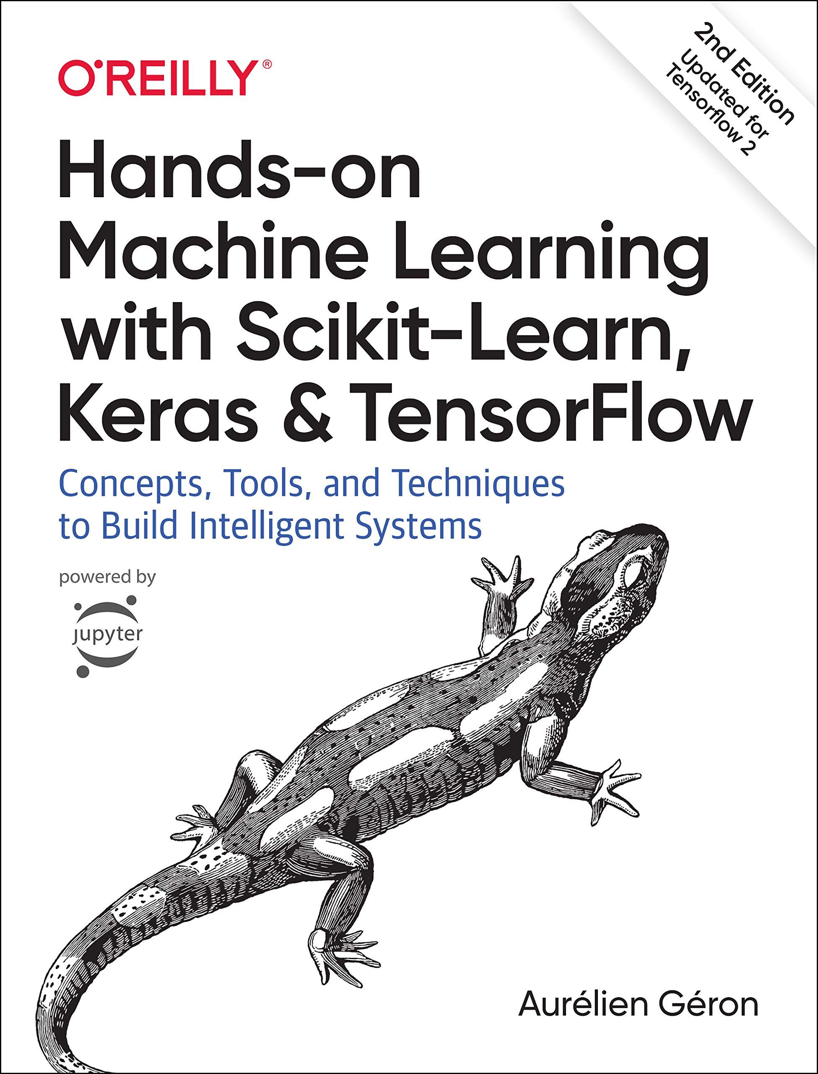


Slide 82

Thank you! Keep learning, this is just the beginning!

